Slide 1
LENDING CASE STUDY

Slide 2
Problem statement:
How can we help minimize the risk of losing money while lending to customers.

Slide 3
Univariate Analysis:
Categorical variables:
Term:

Slide 4
2)Grade:

Slide 5
3)Sub_Grade:

Slide 6
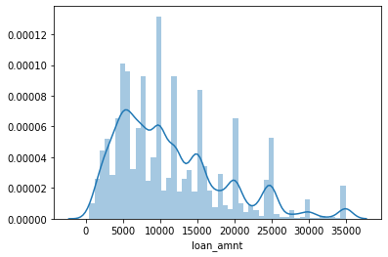
Univariate Analysis:
Quantitative Analysis:
loan_amnt:

Slide 7
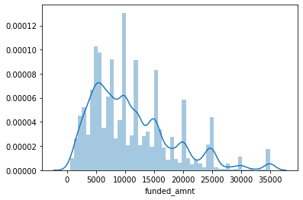
funded_amnt:

Slide 8
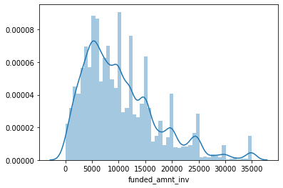
3) Funded_amnt_inv:

Slide 9
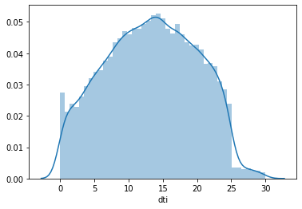
4)Dti:

Slide 10
Bivariate Analysis:
Correlation:
The correlation between funded_amnt_inv and dti is positive , which shows that if funded_amnt_inv increases, the dti decreases and vice versa.

Slide 11
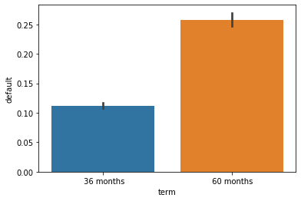
Categorical :
1)Term and Default(chance of a person not to repay the loan):
As the term amount increases the person to be default increases.

Slide 12
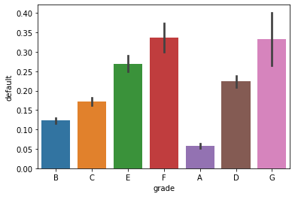
2)Grade and Default:
The persons under the grades E,F,G are at higher risk of repaying the loan there by resulting in a loss.

Slide 13
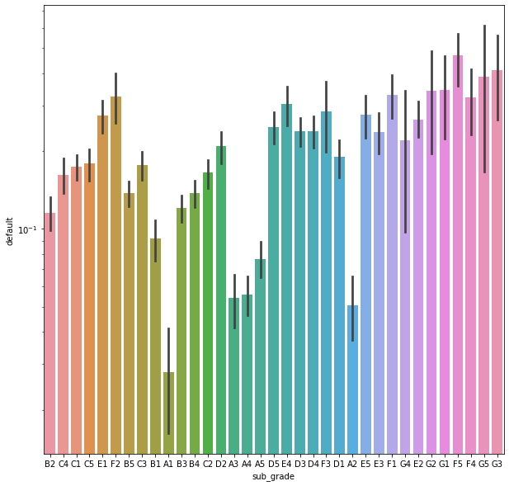
3)Sub_Grade and Default:

Slide 14
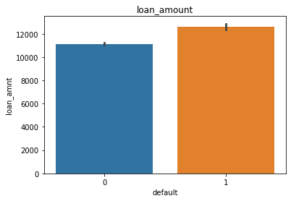
.Quantitative Analysis:
loan_amnt and default(whether a person can repay the loan):
As the loan_amnt increases we can clearly observe that the chances of a person to repay the loan decreases there by increasing the risk of non repaying.

Slide 15
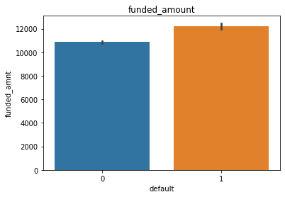
2) Funded_amnt and Default:
As the funded amount increases the risk of a person becoming default increases.

Slide 16
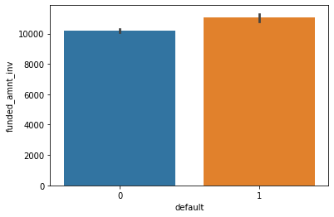
3) Funded_amnt_inv and Default:
As the funded_amnt_inv increases we can observe a clear hike in increase of a person to become default.

Slide 17
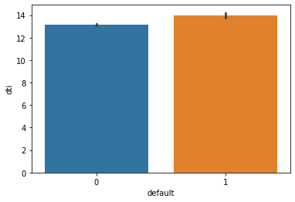
4)Dti and default:
As the dti increases , the chance that a person repays the loan decreases . which implies the total income is inversely proportional to the risk of person to repay the loan.

Slide 18
Result:
1)To minimize the risk of losing money while lending to the customers, the funded amount investment should be low , as the funded amount investment increases the chances of losing the money (a person not repaying the loan ) increases.
2) If the Total income of a person is low then, the chances of that person to repay the loan decreases, there by increasing the risk of losing the money to the investors.

